Slide 1


Creating and capturing value from
innovative tech
Ph.D. Class ENG-642
Business presentation
Team members:

Slide 2
Market opportunities for our innovation
  Describe shortly the key components of your technology, the applications and customers that you discovered and how you chose your Market Opportunity Set

Slide 3
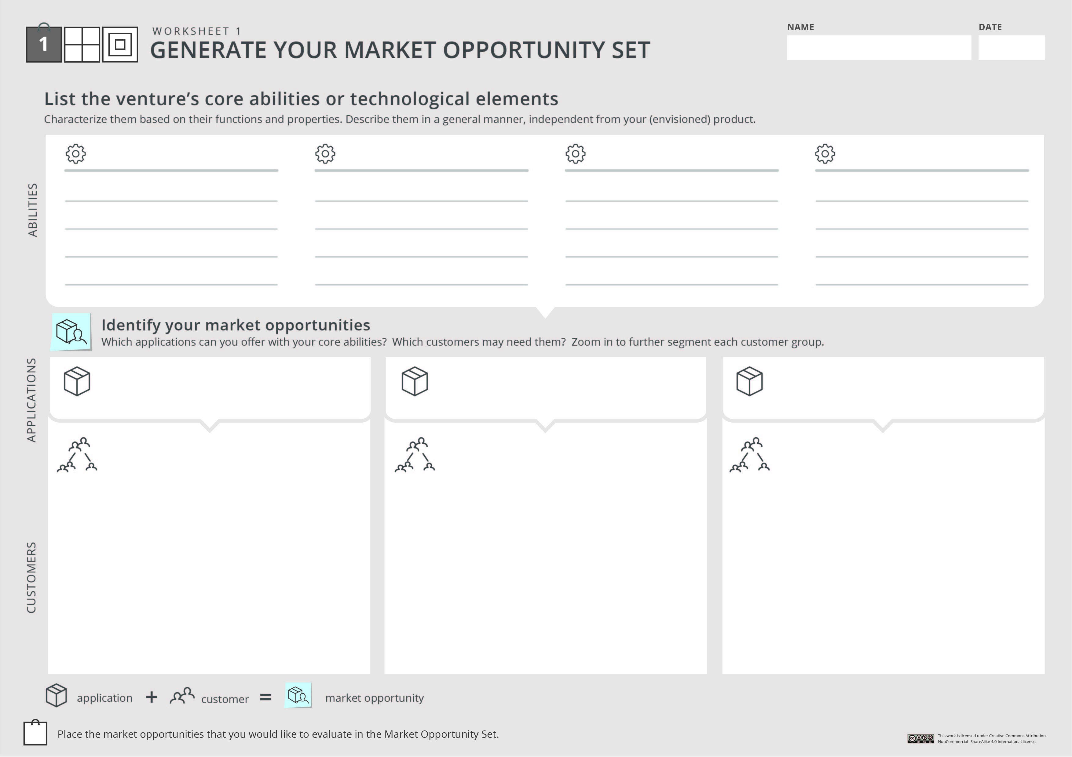

Your project/ startup
Unique ability #1
Unique ability #2
Unique ability #3
Unique ability #4
Functions and properties
Functions and properties
Functions and properties
Functions and properties
Application #1
Application #2
Application #3
Customer segment
Customer segment
Customer segment
Sub segment
Sub segment
….
Sub segment
Sub segment
Sub segment
Sub segment
Customer segment
Sub segment
Sub segment

Slide 4
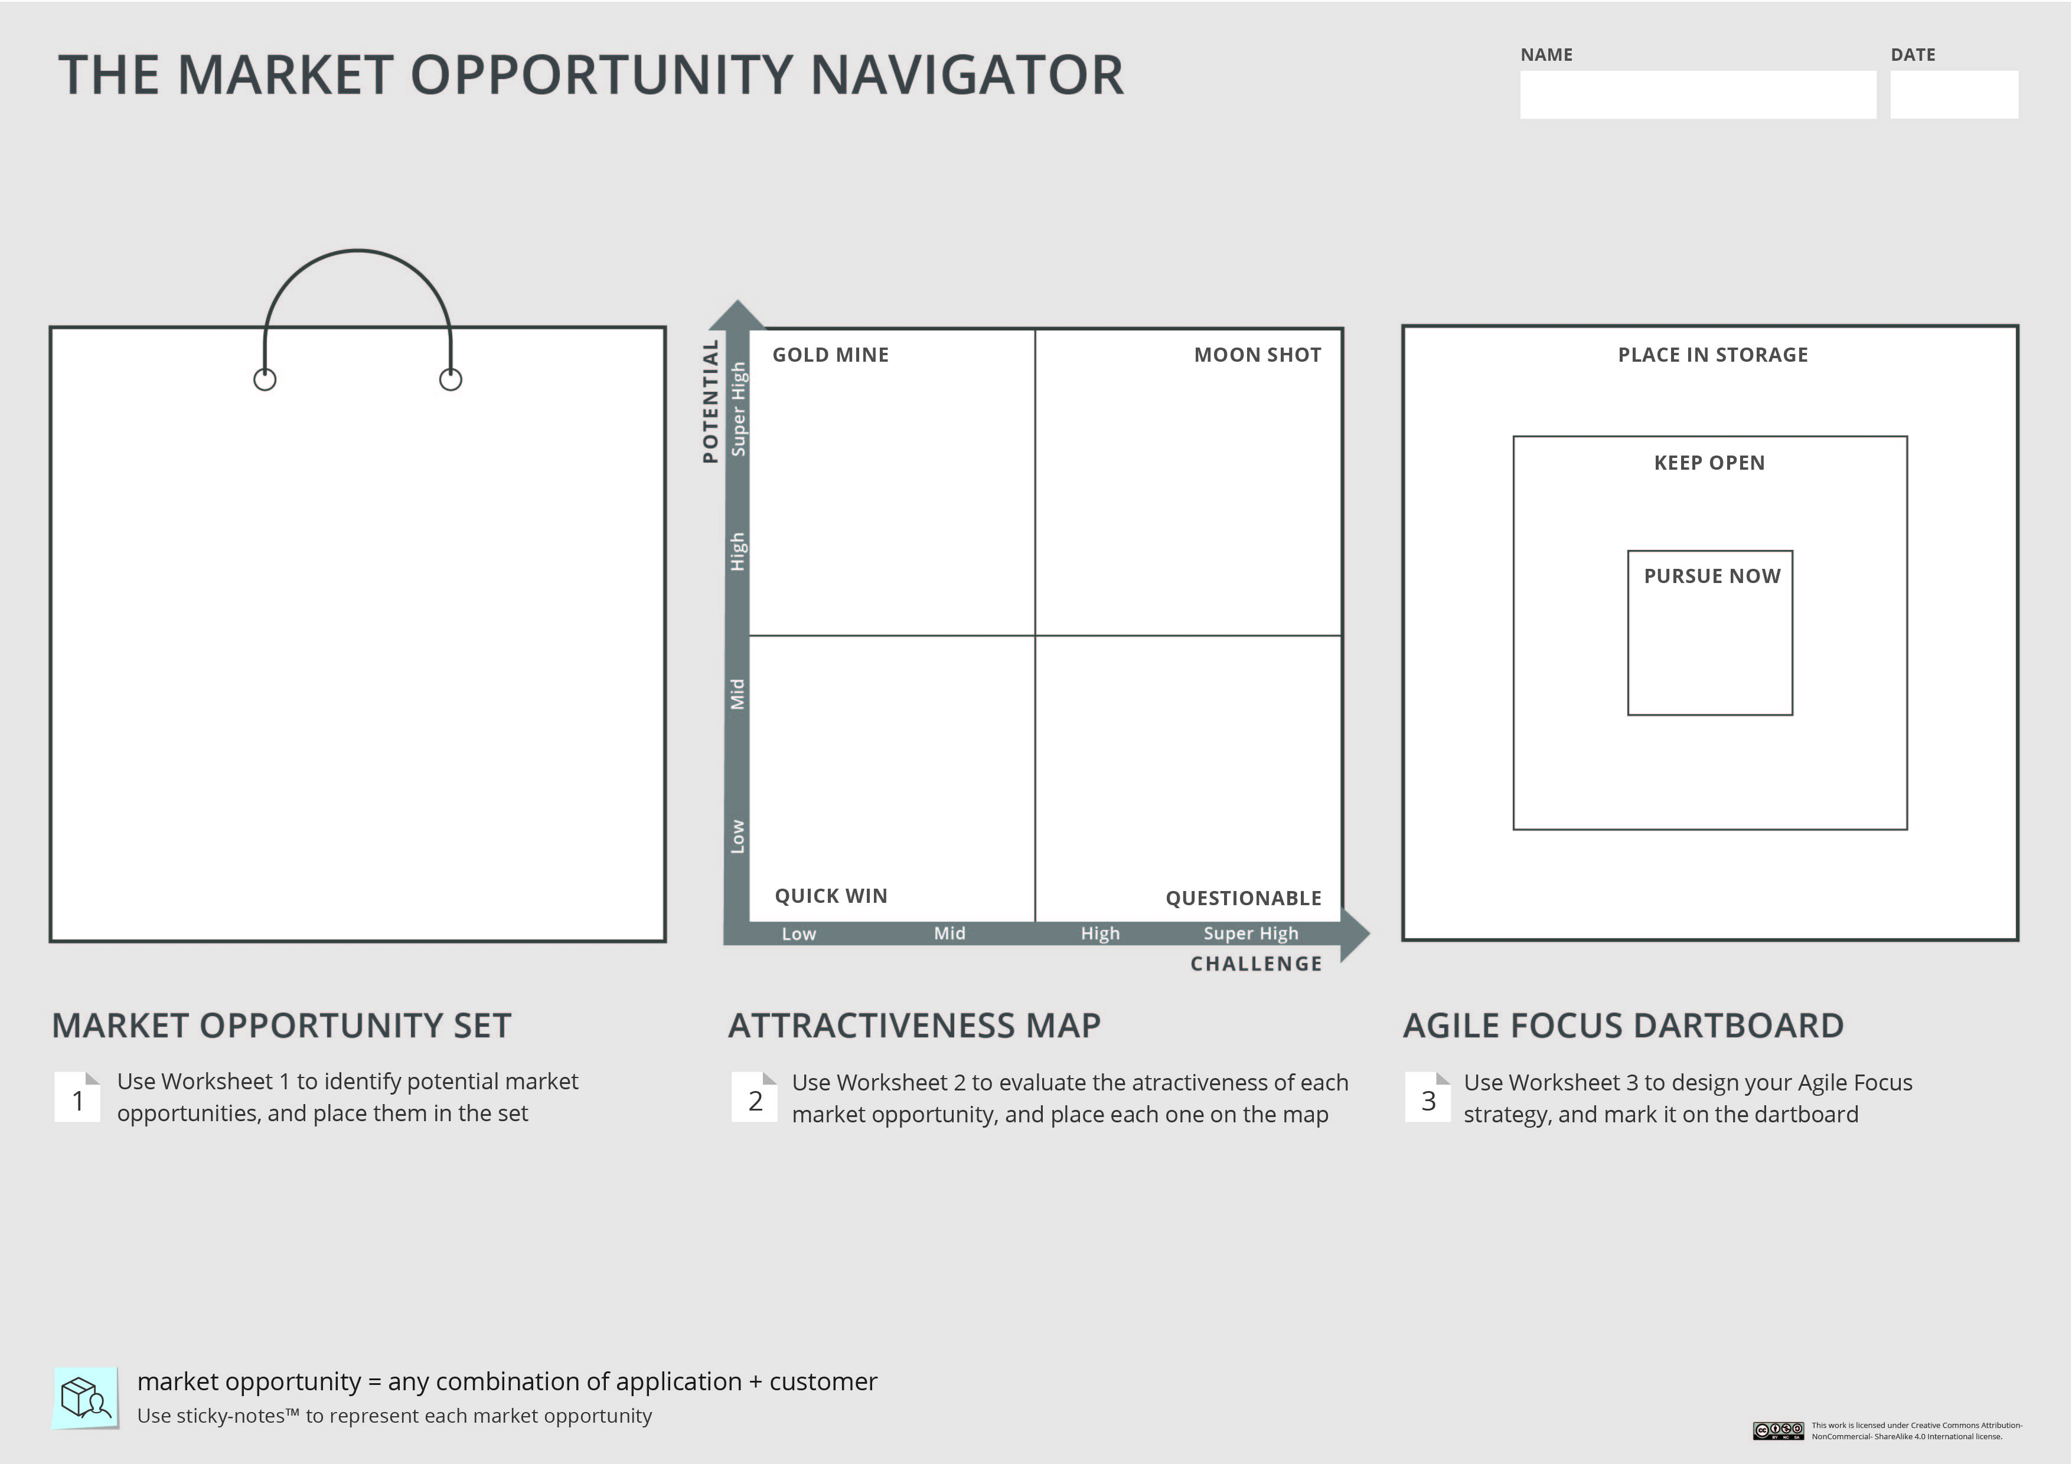
Choose 3-5 market opportunity that you think are worth considering and depict them on your Market Opportunity Set. You can use the sticky notes below
Your project/ startup

Slide 5
Evaluating the attractiveness of an opportunity
  Present the evaluation of one market opportunity:
  Describe shortly who are your customers and what is your value proposition
  Who did you interview and what did you learn
  How did you evaluate the Potential and the Challenge of this opportunity (show the filled Worksheet 2)
  Where is it located on the Attractiveness Map
  If you tried to assess the social/ environmental impact of this opportunity- present it here as well
  If you tried to assess additional market opportunities – show where they are located on the map

Slide 6
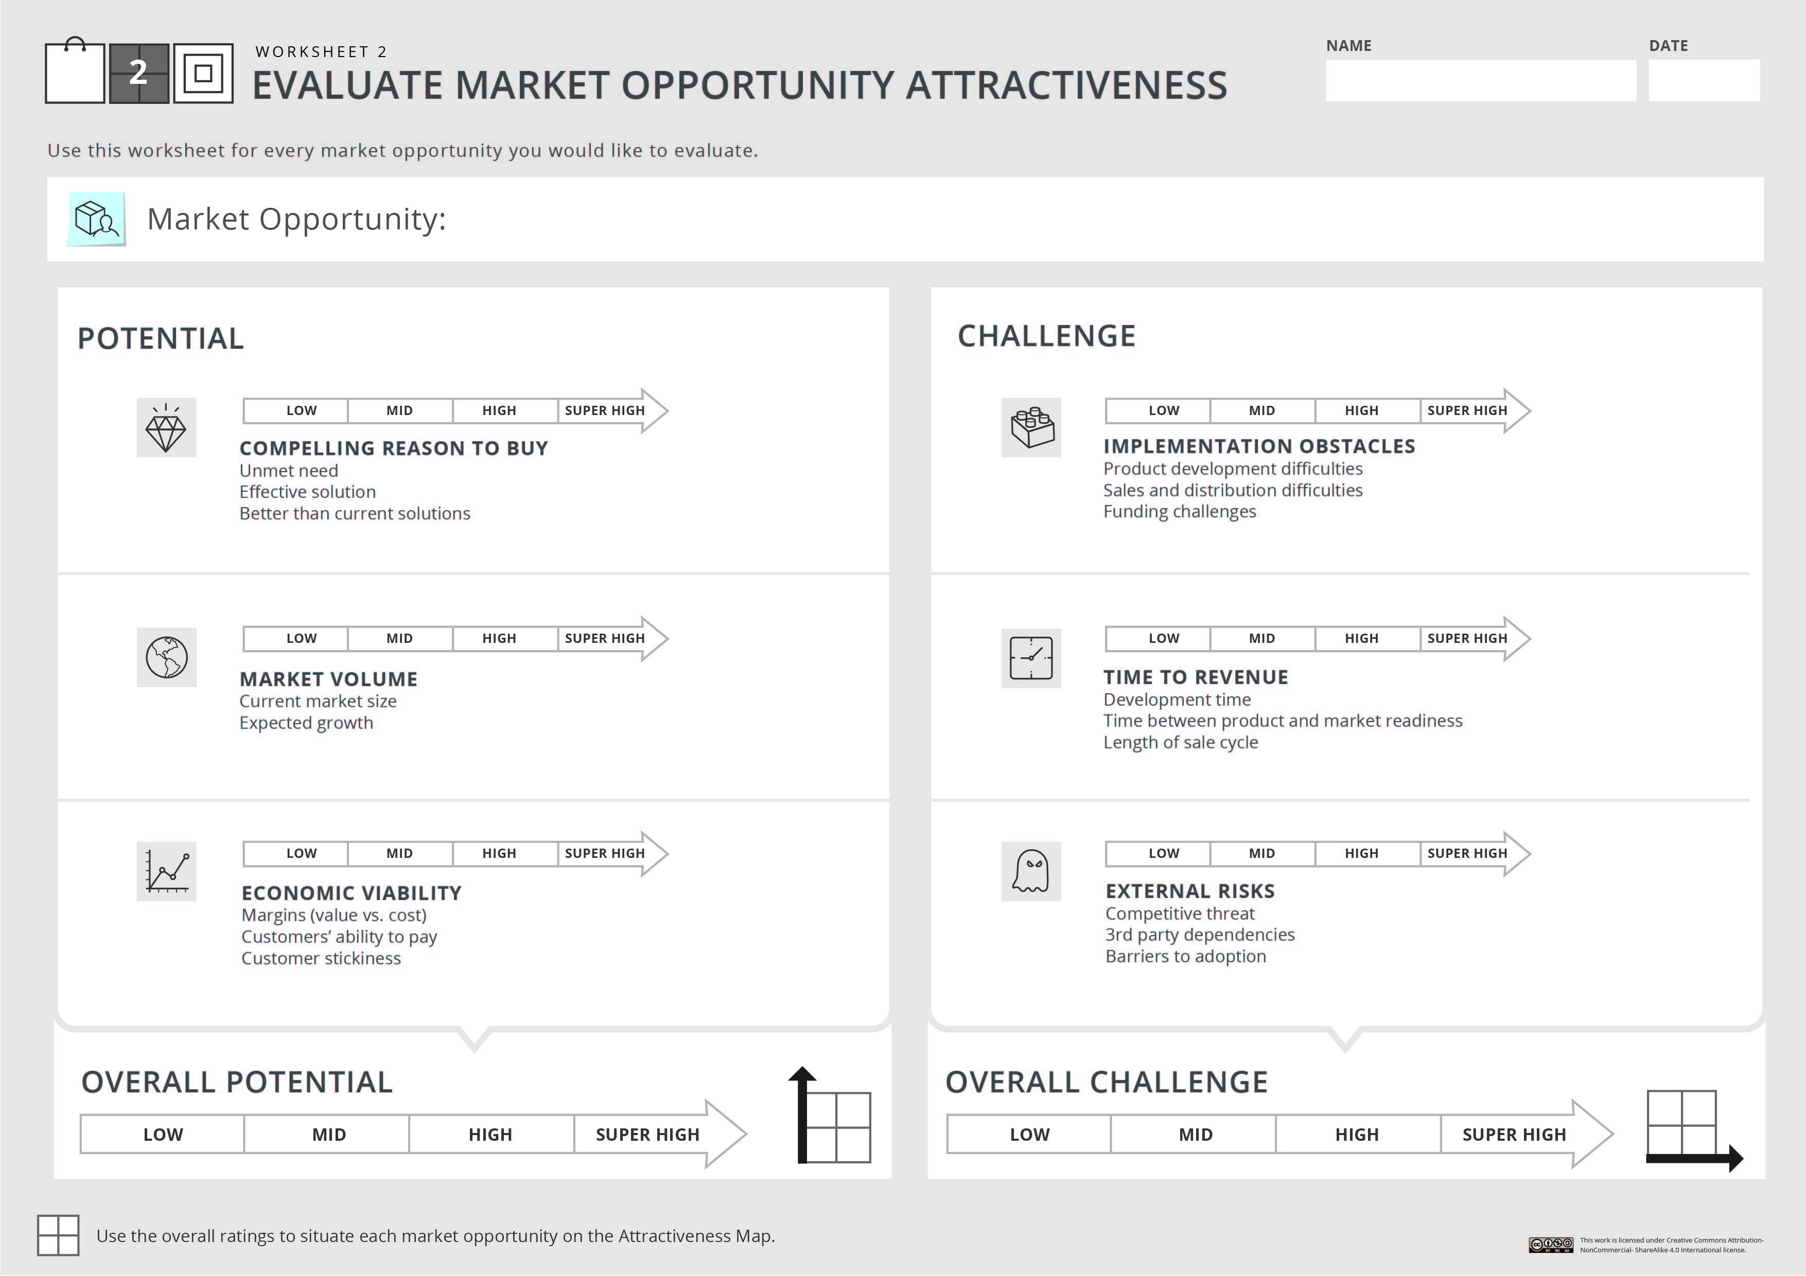

Your project/ startup
Market opportunity name

Slide 7
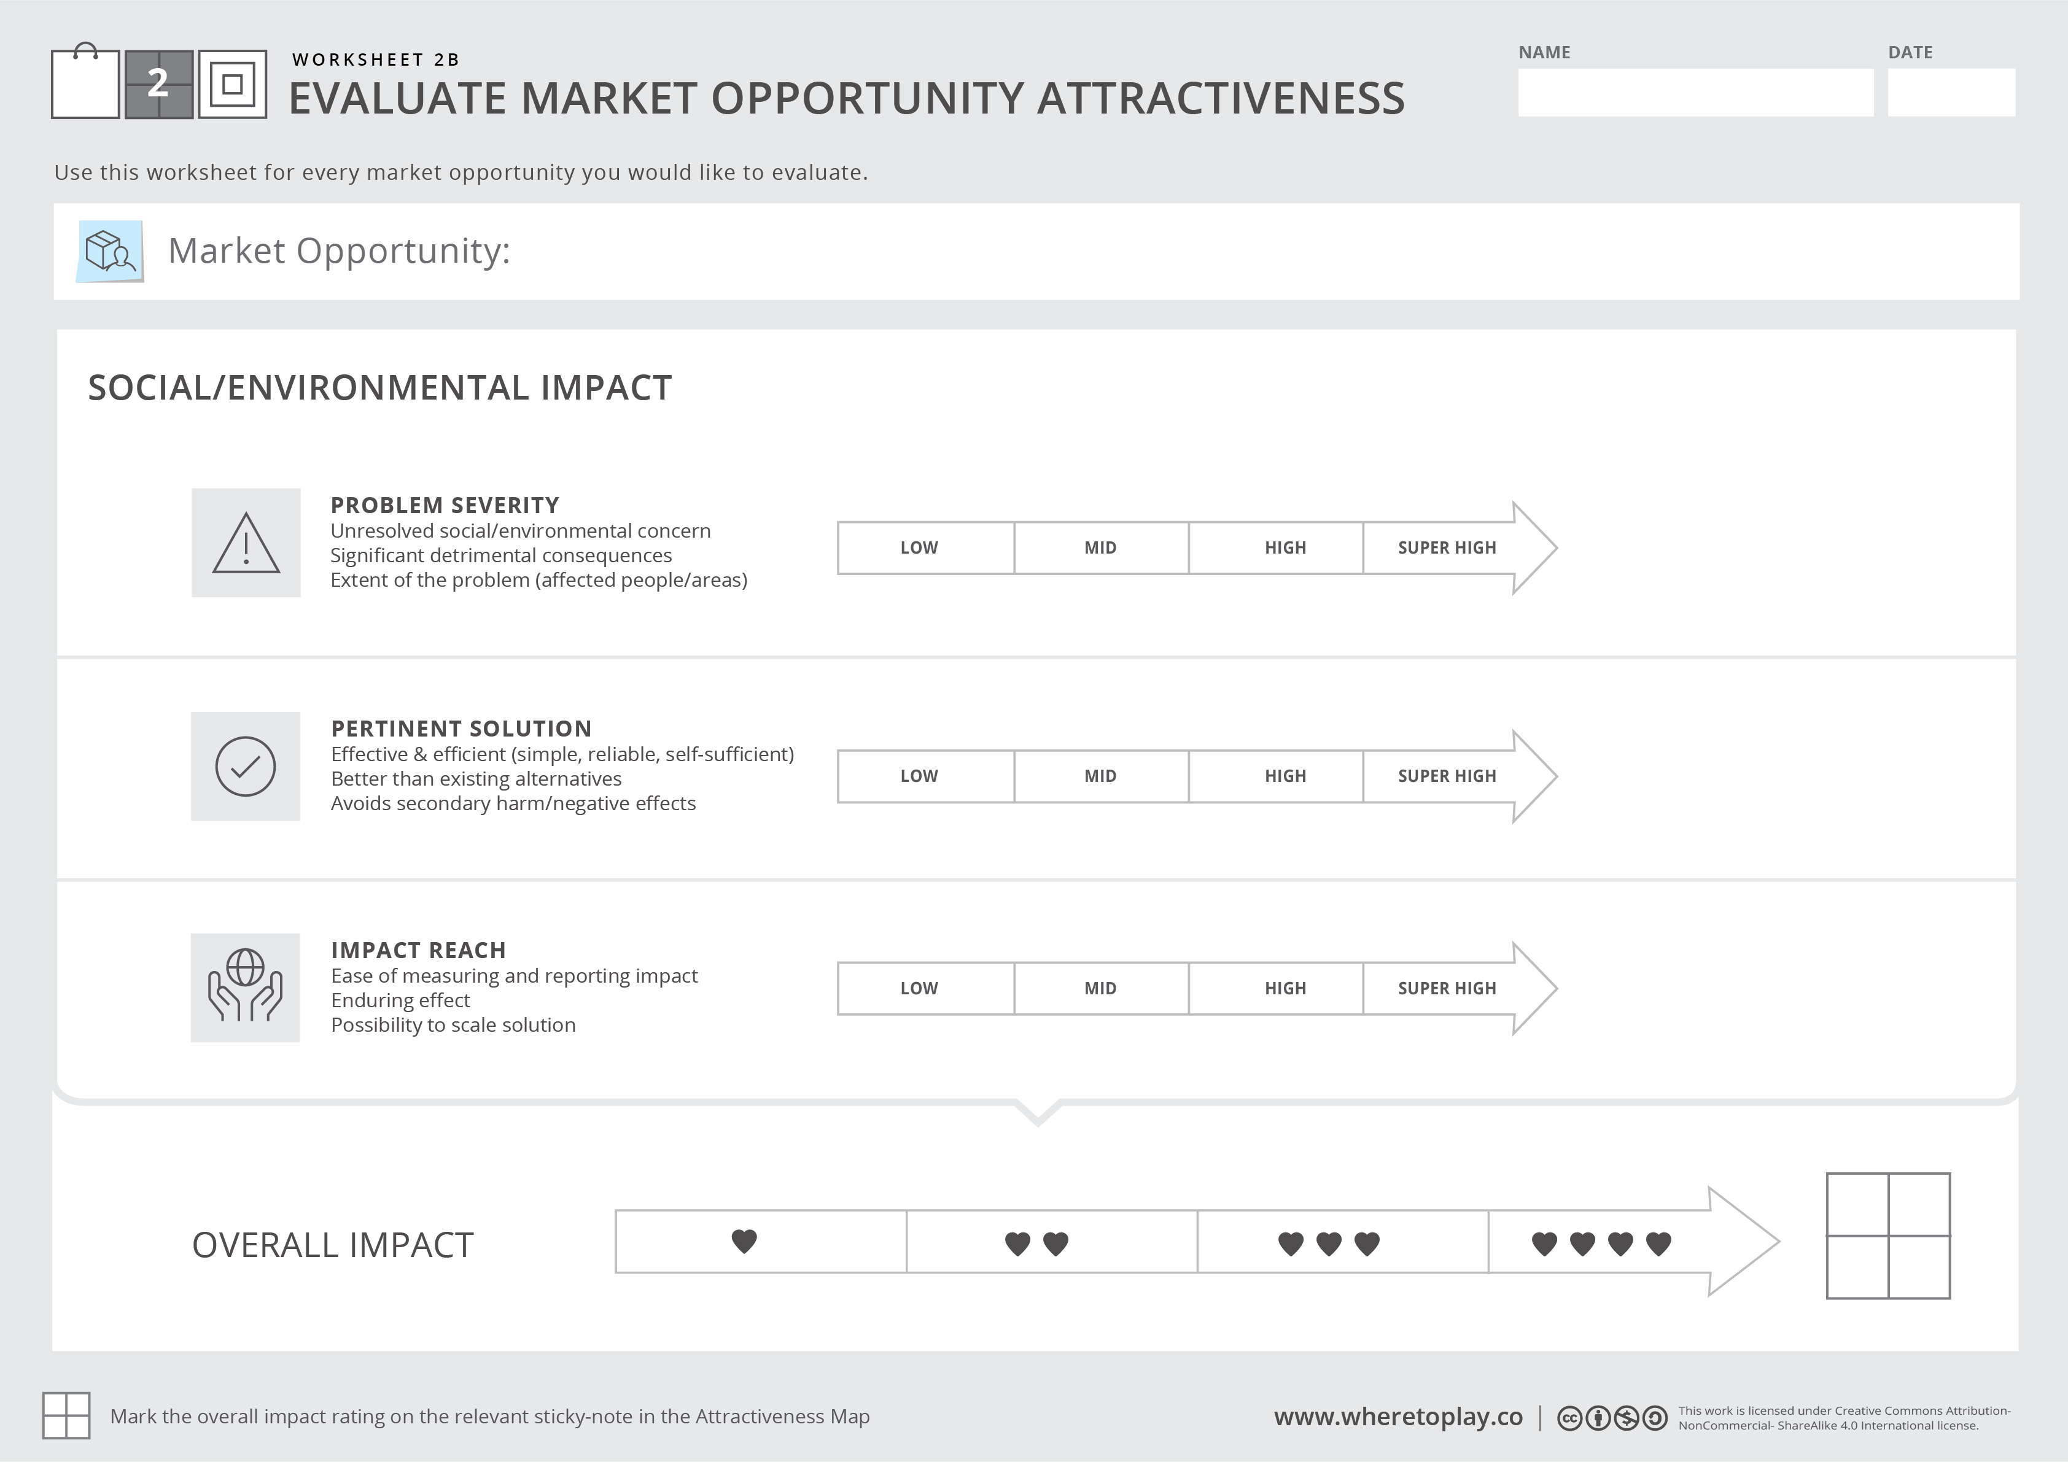
If relevant, show how you assess the social/ environmental impact of this idea

Slide 8
Depict your market opportunity on the Attractiveness Map, based on their overall potential and challenge. Use the sticky notes below if you assessed more than one opportunity
Your project/ startup

Slide 9
Setting our strategic focus
  Describe shortly what is your Primary Market Opportunity, which opportunities do you plan to keep open as Backup or Growth options, and why

Slide 10
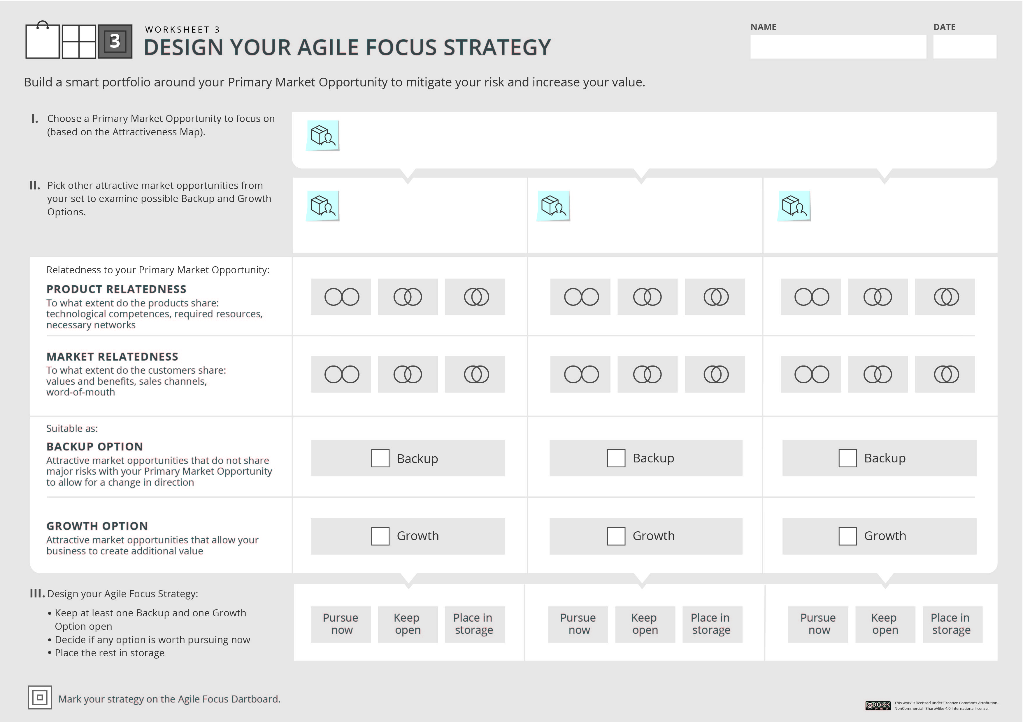

Your project/ startup

Slide 11
Fill out the last step of the Navigator- depict your Agile Focus Strategy on the Agile Focus Dartboard.
You can use the sticky notes below.
Your project/ startup

Slide 12
Team’s takeaways
  What are your takeaways from this learning?
  If you wish to further explore this innovation: what should be your next steps?
  Do you feel any improvement on the transversal skills we highlighted or on other soft skills? Explain why

